Slide 1

Q-One Services
Management consultancy
Q
1

Slide 2

Q-One Profile
The total solution offered for consultancy by Q-One covers the key strategic fields of your operation: quality, health and safety, environment, Laboratory, Designing. Our mission is to enhance your systems and processes in order to create value, relevant to your products, services, people and your assets. Our experts work closely with you by taking your needs into careful account.
We guide and facilitate organizations to define, document, implement and continually improve their working systems based on Quality principles and International standards viz. ISO 9001 QMS, ISO/TS 16949 QMS for Automotive Sector, IMDS, ELV, ISO 14001 EMS, ISO17025 i.e. NABL, HACCP & ISO 22000 for Food Industry, OHSAS 18001,... We specialize in turnkey projects to achieve Certification / Registration.
Q
1

Slide 3

Q-One Profile Continued.......
We at Q-One believe that requirements of Management Systems are unique for each organization and facilitate the development of customized and practical system to suit the organizations requirements. We focus on creating a Total Quality Culture Habit.
We offer a range of industry recognized training programs. The courses are delivered by qualified & competent trainers, who have practical industry experience of working, consulting or auditing.
We Guide Client to Comply to Customer Specific Requirements Audit (VW, GM, Ford, TML etc….)
We have worked with a wide range of clients from Small Scale Industry / Firms to Large Multi Location & Government Organizations.
Q
1

Slide 4
Services :
Consultancy Services available for:
IATF 16949
ISO 9001
ISO 14001 EMS
ISO45001
HACCP, ISO 22000
Information Security Management System Certification - ISO/IEC 27001
ISO17025 , NABL Accreditation
NABH
IMDS
Integrated Management System .
TPM
Lean Manufacturing
5S
Kaizen
Internal Auditor Qualification.
Performance Improvement.
Supplier Development
Third Party Audits
Six-Sigma
CE Marking
IS/BIS Marking
Q
1

Slide 5
Post Certification Services:
Annual System Maintenance Service :
Assistance is system Updation & improvement
Frequent visits for system Implementation follow-up
Internal Auditor calibration.
Participation in Internal Audit to identify more opportunity for improvement in all Processes.
Assistance for Internal Audit.
Assistance for Management review.
Identify & conduct required Trainings.
Guidance for making system more effective & useful for Management.
Ensure smooth System Implementation in case of Manpower attrition.
Third Party Auditing for Suppliers.
Q
1

Slide 6
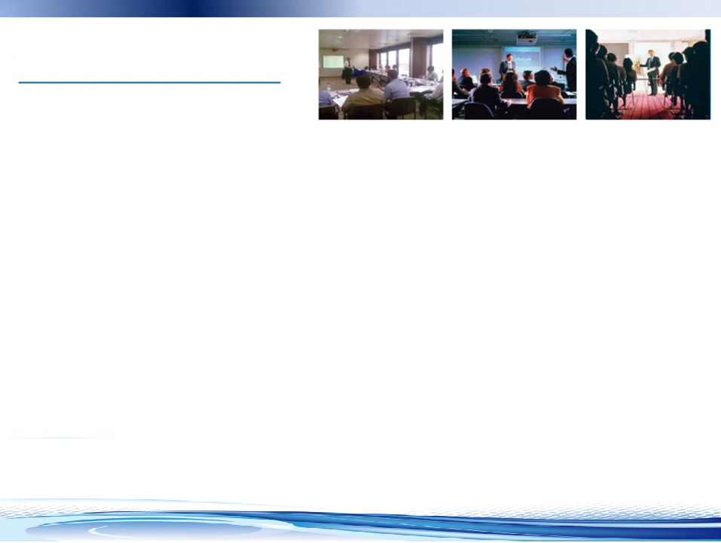
Training:
Q-One Services is rich with a group of qualified and experienced faculty, who will impart the training in the following:
IATF16949 Awareness & Internal Audit
ISO 9001 Awareness & Internal Audit
ISO 14001 Awareness & Internal Audit
ISO45001 Awareness & Internal Audit
ISO27001 Awareness & Internal Audit
ISO17025, NABL Awareness & Internal Audit
APQP-Advanced Product Quality Planning
PPAP-Production Part Approval Process
FMEA- Potential Failure Mode and Effects Analysis
MSA-Measurement System Analysis
SPC-Statistical Process Control
“5S” Housekeeping & KAIZEN –Introduction & Implementation Steps.
Process Qualification & Design of Experiments (DOE).
Introduction to Six Sigma Methodology.
Introduction to Lean Manufacturing.
Introduction to Total Productive Maintenance (TPM).
8D, RCA, Systemic Corrective Action & 7 QC Tools-Problem Solving Techniques.
KANBAN Technique.
Uncertainty Measurement
TS16949 Requirements for Designing.
Customer Specific Requirements. (VW, GM, Ford, TML, etc...)
Q
1

Slide 7
Our Team:
We have the best trained and committed Management Professionals – with related Qualifications & Experienced in Manufacturing as well as Service Sectors.
The Consultants include IRCA (UK) Registered QMS Lead Auditors.
Well Experienced Professionals having successfully implemented and Practically faced the Customer Specific Standards Like VDA 6 etc.
Q
1

Slide 8
Why Q-One Services :
100% Project success ratio.
On time Execution of Projects.
Practical Approach.
Cost effective.
Flexible for Project Duration
Rich in Experience.
Q
1

Slide 9













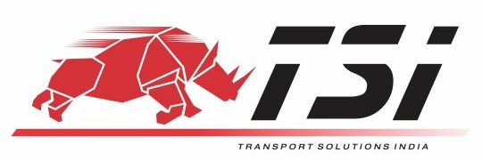










Clients:

Slide 10
Experience in Various Industrial Sectors:
Press Components
IT Industry & Infrastructure.
Packaging
2. Machining
3. Forging
4. Steel making
5. Powder Coating
6. Painting. 7. Textiles
8. Fabrication.
9. Service Industries(Security, Housekeeping, Facility Management)
10. Slitting / Shearing
12 Plastic Molding
13. Casting
Electronic assembly.
Cold Storage.
Stitching.
Rubber.
Plastic Raw Material,
LED Products
Q
1

Slide 11

Contact us:
Q-One Services
Head office:
Plot no. 15, Ashok Vikram Society, Near Ghorawadi Railway Station,
Talegaon Dabhade, 410506, Pune.
Maharashtra, India.
Mob: +91-9552561233/ 9890985482
Email: narayan.kavitake@gmail.com
.
Q
1
1
Q

Slide 12

Thank You.
Q
1

